Slide 1

Network topologies
Topology refer to the schematic description of the arrangement of a network. That is, network topology refers to the actual geometric layout of computers and other devices connected topologies; each suited to specific tasks and having its own advantages and disadvantages . Some of these topologies are explain in this tutorial.
Bus Topology
Star Topology
Ring Topology
Mesh Topology
Hybrid Topology

Slide 2

Bus Topology
In a bus topology , each computer or server is connected to a single cable. Hence , all the nodes share the same communication channel . When a node want to a send a message to another node , it creates a message and adds the address of the recipient to it. Then , it checks whether the line is free or not.
Advantages :
Easy to install and connect a new devices to the network.
Require less cable length than the star topology.
Disadvantages :
In case of network shut down , it becomes very difficult to identify the problem .
As the number of nodes increases ,the speed of the network slows down .

Slide 3
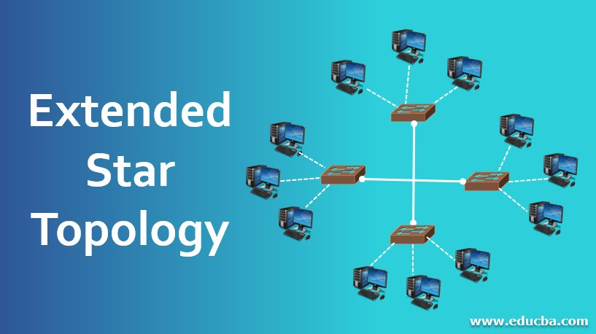
Star Topology
The star topology is considered the easiest topology to designed and implement . In this topology ,each node is connected to central hub with a point connection . All traffic that are traverses the network passes through the central hub. That is ,it is a host node that controls communication between other nodes.
Advantages :
Easy to install.
New nodes can be connected easily .
Disadvantages :
Requires more cable length than bus topology .
If the central hub fails, the entire network is shutdown.

Slide 4
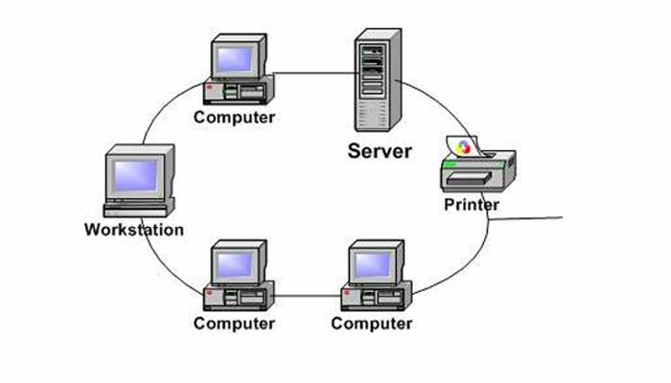
Ring Topology
In a ring topology , all the nodes are connected to each other in the shape of a closed loop , so that every node is connected directly to two other nodes , one on either side of it.
Advantages :
Easy to install .
Can span over larger distances .
Disadvantages :
Difficult to add or remove nodes from the network .
In causes of network failure , difficult to diagnose the fault .

Slide 5
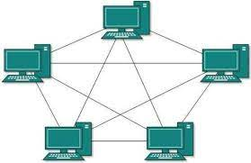
Mesh Topology
In a mesh network , also known as completely connected network , every node is connected to every other node on the network using a separate physical link .
Advantages :
It is easy to detect network errors .
Communication is fast as there is a direct link between the nodes .
Disadvantages :
It is difficult to install .

Slide 6
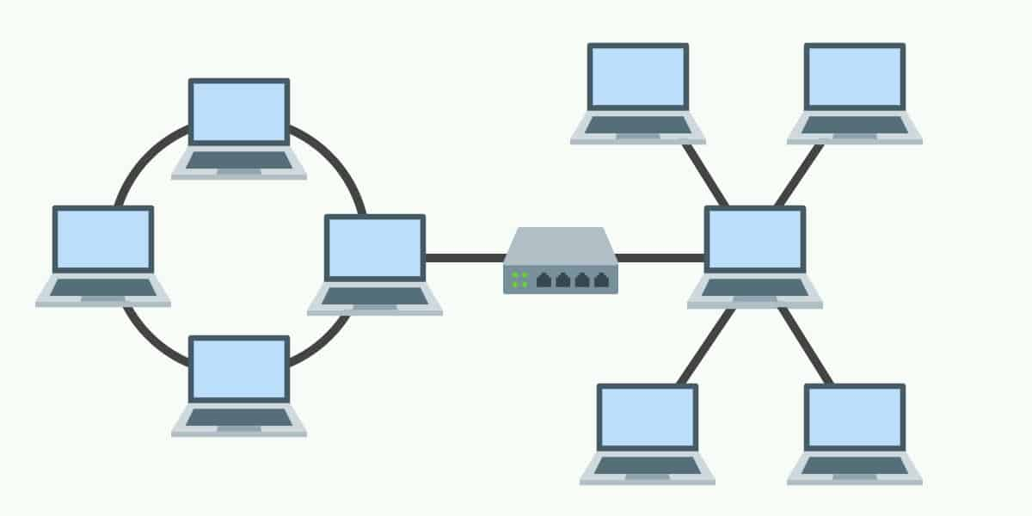
Hybrid Topology
We have discussed the star , ring ,bus and mesh topologies .
Two very common hybrid network used topologies include the star-bus and star –ring networks .
Advantages :
Flexible : Hybrid Topology is the most flexible network topology as it can be changed and assembled using different structures of topology.
Very effective : This topology is highly effective as user can use different topologies according to their needs .
Disadvantages :
It is a type of network expensive .
Installation is a network process .

Slide 7
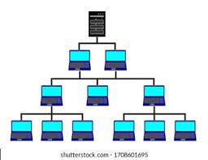
Tree Topology
In computer networking , tree topology is a type of network topology that resembles a tree.
This is combination of bus and start topology .
Advantages :
It is easy to expand the network .
Even if one network (star) fails , the other network remain connected and working .
Disadvantages :
Installation complexity is more that topology .

Slide 8
Conclusion
Due to its centralized nature , the topology offers simplicity of operation .
It also achieves isolation of each devise in the network .
Adding or removing network nodes is easy , and can be done without affecting the entire network .
Created by-Roshni Verma

Slide 9
THANK YOU

